Slide 1
Intro to Physical Computing aka How to make Daft Punk Helmets 101.
CC Lab (Fall 2016)

Slide 2
What’s an “Arduino”?
Microcontroller
Input/Output machine
Made for rapid prototyping
(without requiring custom boards design)
Open source
Large community to support it
Notes:
An arduino is just a rapid prototyping platform. It is a VERY simple device and, at its simplest form, should be thought of as a simple input/output processor. It receives inputs from the outside world (via buttons, sensors, switches, etc.), makes some decisions (based on programming) then performs an action (LEDs, motors, buzzers, etc.)

Slide 3
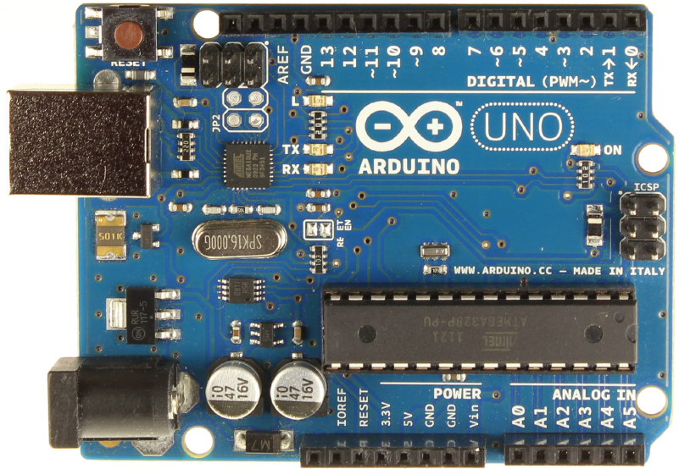
What’s on the board?
Notes:
A lot. The Arduino company has a lot of different microcontrollers but the most popular is the UNO. This is made to be a very robust and rapid prototyping device. Its as big as it is to accommodate all those pin slots and ports which make it easy for people to plug/unplug wires from quickly and reliably.

Slide 4
The Brain - ATmega 328p chip
You can also pull it out.
Careful! Don’t bend the pins
Notes:
This is really what is doing all the processing on the board. Everything else around it is just a support for it.

Slide 5
Digital Pins
Notes:
These are the arduino’s connection to the world. These pins can be configured as inputs or outputs. They are called “digital” because they are binary, they can be on or off. On = 5 volts, off = 0 volts.
Output = “Lets turn this LED/Motor/Buzzer/etc. on or off”
Input = “Is this button/switch pressed or not pressed?
PWM allows us to trick things into turning on and off at different levels between 0 and 5 but we’ll cover that in another class.

Slide 6
Analog Pins
Notes:
Analog pins are solely inputs. These pins are used when we want to get a bit more information than on/off. These can read information on a range. For example, reading a light sensor via an analog pin will read the voltage on that pin on a scale from 0-1023. Bright light on the sensor might read close to 1023, putting the sensor in a dark room might read close to 0.
Why 0-1023? The hardware on the arduino (specifically the analog to digital converter or ADC) can only read voltage differences that are so fine. 0-5 volts divided by 1023 steps means the arduino can distinguish differences in voltage of about 4.8 mV (0.0048 volts). Not bad.

Slide 7
Reset Button
Notes:
This button will come in handy. It just cycles the power and turns the arduino on and off, causing it to start the code that’s on it from the beginning.
Note: Once code is uploaded to the arduino it is on there for good, until new code overwrites it. This means disconnecting it will not erase the code. However, there is NO WAY TO GET CODE FROM THE ARDUINO. You just can’t so save all your sketches.

Slide 8
USB Port
Notes:
This is where the USB cable goes. This cable is a connection to the computer so you can communicate with it via a “Serial” connection with your computer. This cable will also provide power to your arduino.
Note: your computer will only be able to provide so much power via the usb port so if you’re using anything more than a few leds or a buzzer, think about using an external power supply.

Slide 9
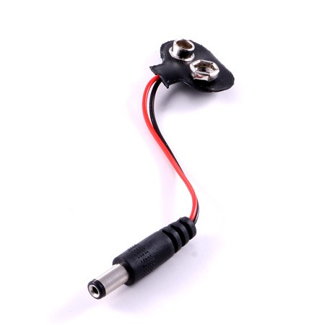
Power Jack
Notes:
This is where you can connect an external battery pack using a “2.1 mm barrel jack” you can get from RadioShack. The one in the photo connects the other side of the barrel Jack to a 9 volt battery which is convenient for disconnecting the arduino from a computer or wall outlet and becoming portable.

Slide 10
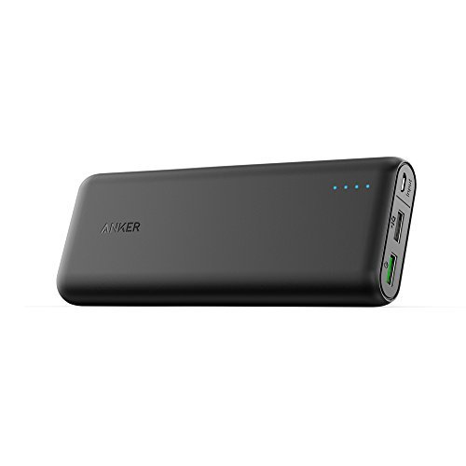
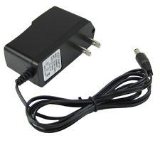
PRO-TIP: Buy one of these
Specs: http://playground.arduino.cc/Learning/WhatAdapter
Notes:
Just search for 9 volt wall adapter on eBay or Amazon and you can find them for like 6 bucks.
Pros:
Can supply more current than your computer’s USB port.
They come in different voltages (5v, 9v, 12v, etc) to suit the needs of different components (e.g. a fan or LED strip might need 12 volts to run)
9 volt batteries run out of juice fast. When it does the arduino will behave erratically and you will never guess that its the battery because “I swear to god I just started using a new one”
This will allow your project to live indefinitely on its own without a computer. Just in case you’re into that sort of thing.
Cons:
There are none. Buy one.

Slide 11
Voltage Regulator
Notes:
Pretty much everything on the arduino and most things we’ll use with it run off 5 volts. The V-Reg’s job is to convert power from the power cord, the usb cable and external battery packs into a nice, smooth 5 volts. If you aren’t careful with your wiring, something accidentally causes a short and the arduino isnt responding anymore, check and see if this is hot. If you burn your finger, you probably burned it out by sending too much electricity to the wrong place. Sucks to be you.
The voltage regulator can convert anything from 5-18 volts down to the 5 volt level. Best practice: don’t give it more than 12v.

Slide 12
Vin, 5V, 3.3V, GND, Reset pins
Notes:
Listen carefully:
Vin
Vin will give you access to whatever raw voltage goes into the barrel jack. E.g. if you have the arduino connected to a 12 volt power supply the Vin pin will also have 12 volts. However, use this sparingly since the arduino still can’t handle that much current going through it. There are other safer ways to power big current loads (motors, bright lights, etc.) which we’ll cover later.
5v
This pin will connect you to the nice smooth 5 volts from the voltage regulator. You will connect this to your breadboard (which we will discuss later)
3.3v
Some components will require 3.3volts, not 5. In that case you can give them their own 3.3 volts using this pin. If you give them 5v they will burn out. So be sure you’re using a 5 volt component.
GND
Pretty much everything will need to be connected to ground. That’s how the circuit is completed. That’s why there are 3 of these (can you find the 3rd one?)
Reset
This pin will allow you to have the arduino reset itself. Connecting this pin to a ground source (e.g. literally running a jumper cable from GND to Reset) will cause the arduino to reset itself. You can also connect it to a digital pin and have that pin trigger a reset via software which is occasionally useful.

Slide 13
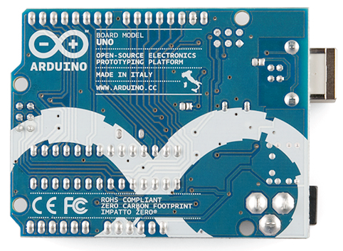
Back of Arduino
Notes:
See all that exposed metal on the bottom of it the arduino? Be careful of what surface you put it on. Like your shiny Macbook Pro or pile of scrap copper wires.

Slide 14
Internal LED
Notes:
The arduino has an internal LED on pin 13 (the one marked “L” sitting close to pin 13) that you can control without having to add any extra hardware. Helpful as a debug, we’ll see this later in class.

Slide 15
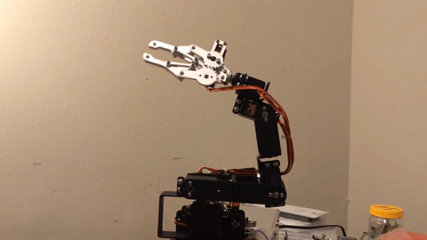
YAY ELECTRONICS!
Notes:
In order to get things working (and not blow stuff up) we need to understand a few key ideas with electricity. This will basically be a crash course through electrical engineering 101

Slide 16
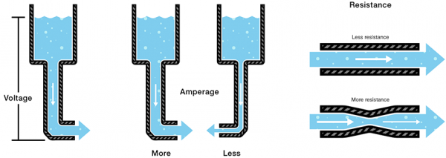
Ohms Law: V = IR
Notes:
As much as the two don’t mix, it’s really helpful to think of an analogy between electricity and water.

Slide 17
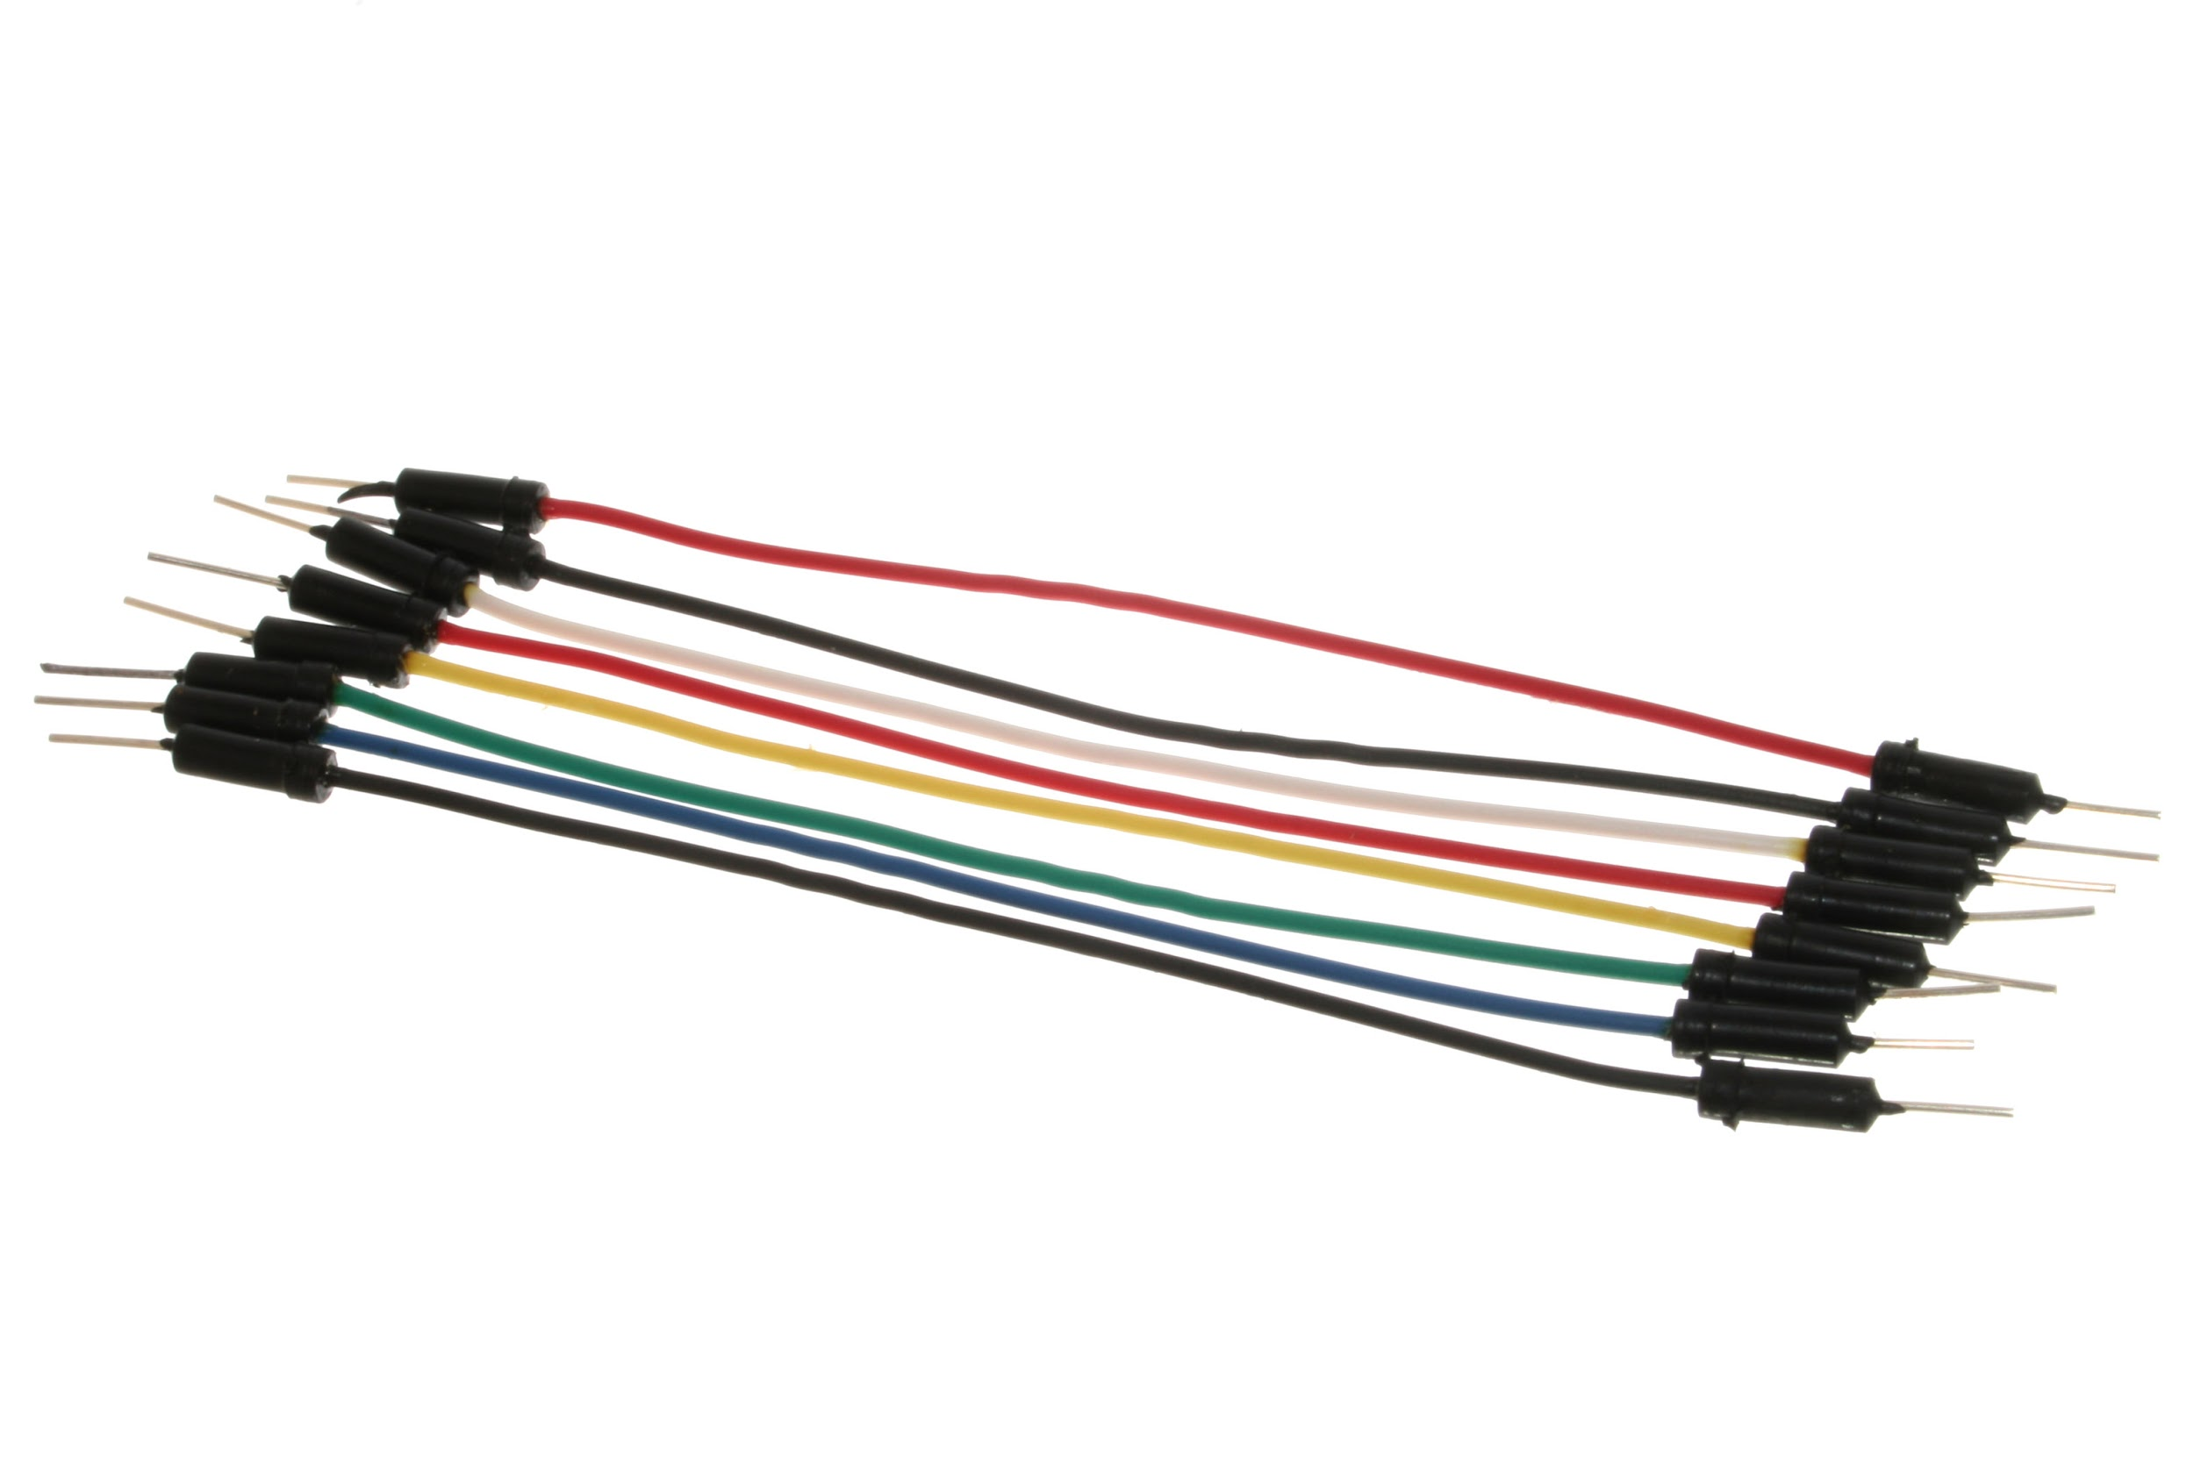
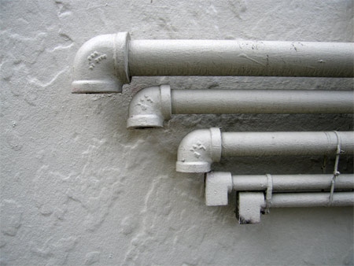
Wires = Pipes
Notes:
Simple. Get it?

Slide 18

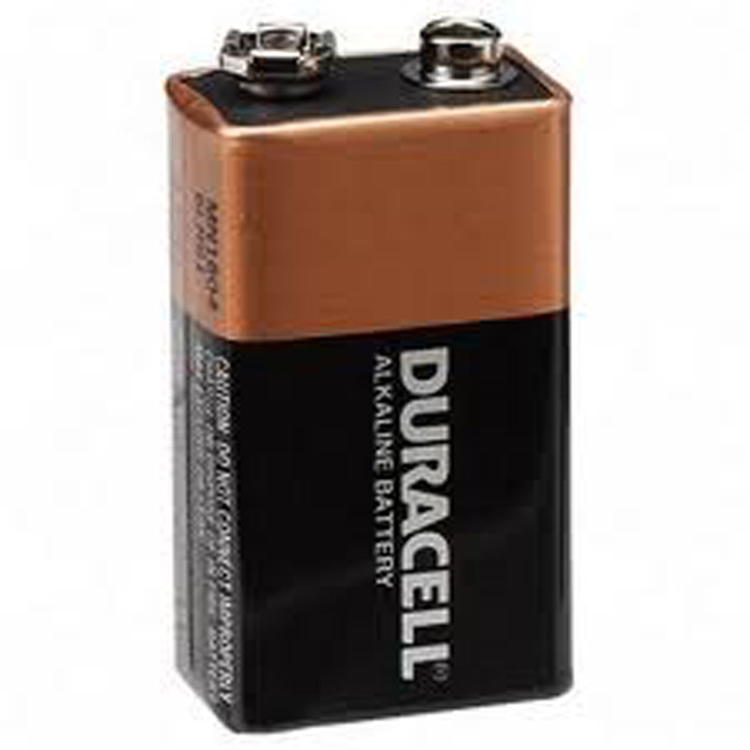
Battery = Water Pump
Notes:
The battery is like a pump, its responsible for pushing the water through the pipes. The battery works in a very similar way. The battery literally PUSHES electrons through with a certain amount of force. This force is measured in voltage. A 12 volt battery will push those electrons through with more force than a 1.5 volt AA battery.
This is why things burn out. 12 volts from a battery will force current through places it’s not supposed to go if you connect it to a component designed for 5 volts.

Slide 19
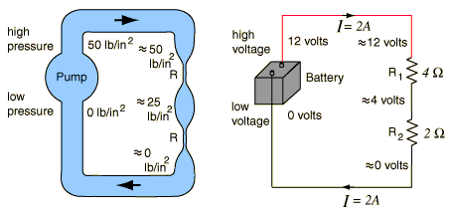
Voltage (V) = water pressure
The force with which electrons are being pushed through the wire
Notes:
Think of voltage as being the force with which the electrons are being pushed through the pipe by the battery.
Its like the force with which the water is being pushed through the pipe by the pump. Very similar.

Slide 20
Current (I) = how much water flow
The amount of electrons moving through the wire at any given moment
Notes:
Contrast voltage directly with current.
The current is the actual amount of electricity flowing through the wires. Or the flow rate of water through the pipe. Electrical current is measured in Amperes or Amps and has the symbol I (capital i). Most of the things we’ll do with the arduino will be rated in milliamps, mA or thousandths of an amp (1 A = 1000 mA).
Illustrating examples:
The arduino loves 5 volts but it can only output about 40 mA per digital pin. A motor or high power LED might also run off 5 volts, but the arduino will not be able to suply the 1-2 amps the motor might need to spin well or the 400mA the high power LED will need to even turn on.
Your computer can only supply a certain amount of current (electrical flow). Again, not enough to handle big current loads.

Slide 21
Resistance (Ohm or Ω) = Pinched pipe
The amount of electrons moving through the wire at any given moment
Notes:
Resistors are like having a pinched pipe. These will limit the amount of voltage available to a component. Resistance is measured in Ohms.
Most common use: A digital pin outputs 5 volts but a common LED can only handle about 3 volts before it burns out. Connecting it with a resistor lowers the voltage to a usable level so the LED can light up but not blow up.

Slide 22
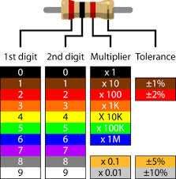
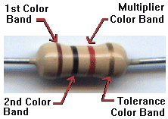
Resistors
Notes:
There are a million different resistors ranging from 1 ohm all the way to 10 mega-ohms (10,000,000 ohms) and beyond. However, some are more common than others. Resistors are NOT polarized. This means you can connect them forwards or backwards and it wont matter.
Your kits will most likely have two kinds:
10 kilo-ohm (brown-black-orange)
This is somewhat high and is usually used for connecting sensors and buttons.
200-600 ohms (most common 330ohm = orange-orange-brown)
This is somewhat lower and is usually used in combination with LEDs so lower current a little but not too much.
Search google for resistor color code chart or download an app. Its not too hard to figure out.

Slide 23
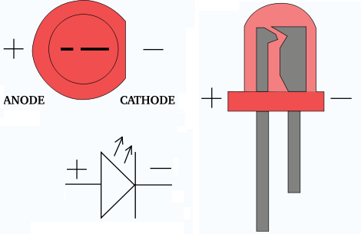
LEDs
Notes:
LED stands for Light Emitting Diode. Its basically a little piece of semiconductor that emits light when you run the right amount of current through it.
LEDs are polarized this means they will only work in one direction. There are a few ways to tell: most LEDs will have one leg shorter than the other. The short leg will always go towards ground. Always. Another way to tell (especially after you clip the LED legs or its in a breadboard) is to look for the flat spot around the collar of the LED. The flatspot indicates the side going to ground.

Slide 24
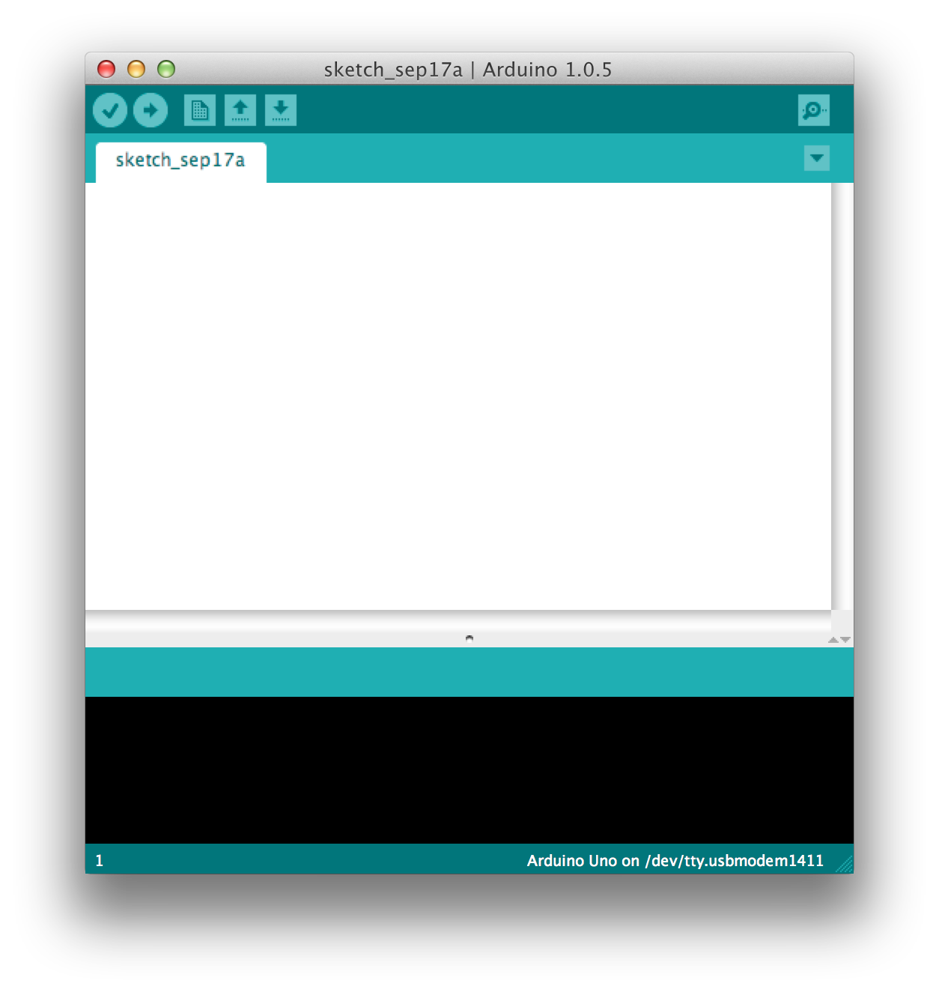
Arduino IDE (Integrated Dev Environment)
Notes:
Open up the Arduino program on your computer.
This is the Arduino IDE. Code goes in the white part, the black part is the console where you’ll get error messages.
Similarities to Processing:
All your programs are saved in your sketch folder
There are a bunch of examples for you to explore
There are libraries that you can access right off the bat, but you can find more to install and use
There is a huge online reference you can access as well as tons of forums to search through.
Don’t think of the IDE as where your arduino code runs. It doesnt. Think of this as a viewport into the arduino itself. That’s where code is running. All code is uploaded from here to the arduino THEN it runs. If you disconnect the arduino from the computer and into a battery, the arduino will run exactly the same way.

Slide 25
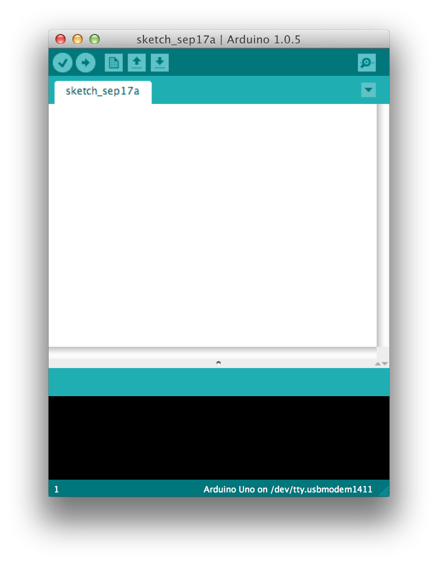
Verify Button
Notes:
This is the verify button. It checks your code to make sure there aren’t any syntax errors or anything the arduino won’t understand.
It does NOT tell you whether your code will work or not.

Slide 26
Upload Button
Notes:
The upload button will verify your code automatically THEN upload it to your arduino. This will overwrite whatever code is on your arduino. Again, there is no way of retrieving code once its on the arduino so make sure you save your stuff.

Slide 27
New, Open, Save...
Notes:
New, Open, Save. Obvious.

Slide 28
Serial Monitor
Notes:
The arduino does not need to communicate with the computer once the code is uploaded. We could disconnect from computer, plug into a batter and the arduino would never notice.
The Serial monitor is a communication protocol that allows a line of communication to open up between the arduino and the computer so we can send and receive messages, either for debug or to have the arduino communicate with another device via serial
NEVER USE DIGITAL PINS 0 or 1. These are receive/transmit pins the arduino uses for communication. Anything plugged into these will prevent you from uploading/connecting to the arduino.

Slide 29
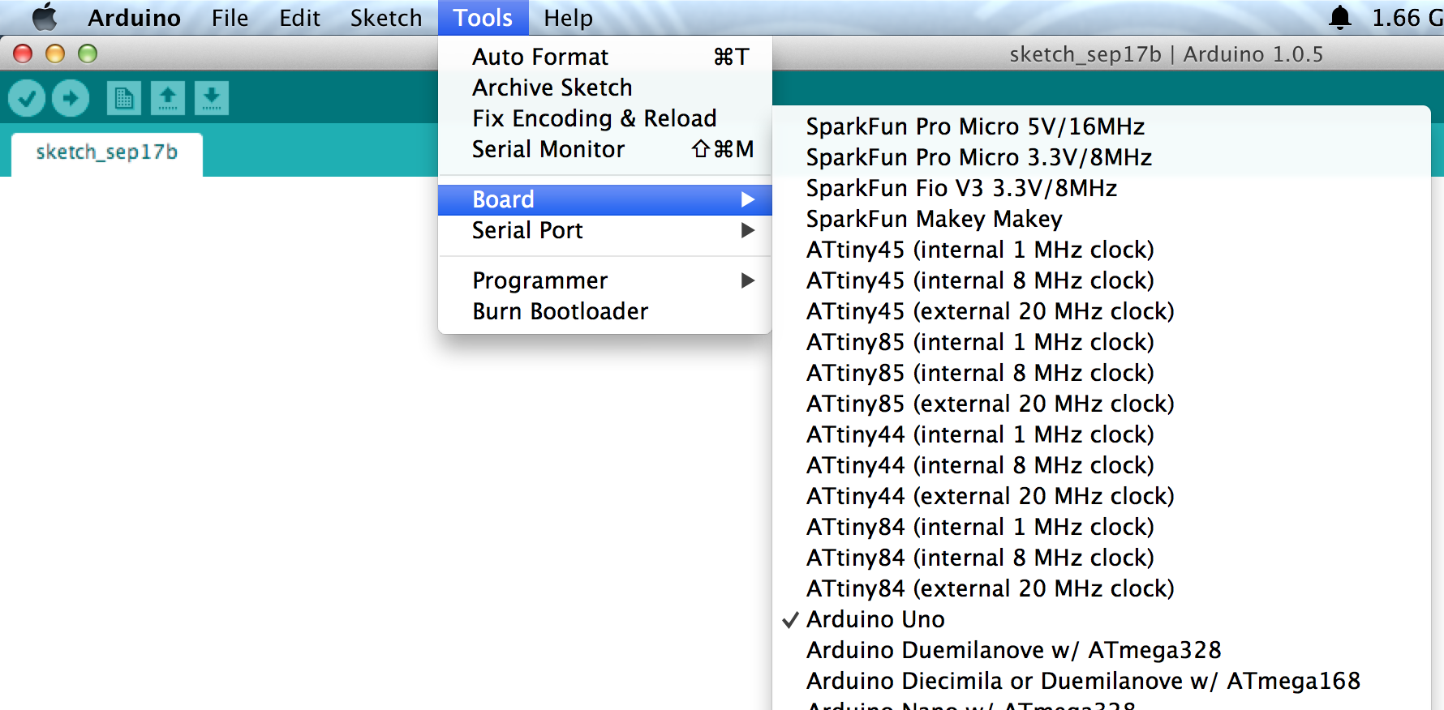
Tools > Board
Notes:
Make sure you have the right board selected. Most of you will have an UNO.

Slide 30
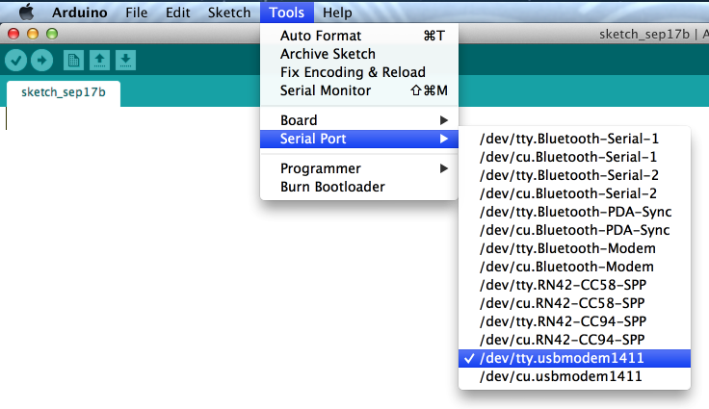
Tools > Serial Port
Notes:
So, our computers don’t really have Serial ports anymore. Its a thing of the past. We now use virtual serial ports that communicate the same way except via usb instead of the big clunky serial cables we used to have. Tools > Serial Port will list all the virtual serial ports on your computer so you can select which one the arduino is on.
You may or may not have a bunch of serial ports in your list. The easiest way to know which one is to check the list BEFORE you plug your arduino in then check it again right after you plug it in. Yours is the new one.
Your serial port wil look like:
Mac: /dev/tty.usbmodem1411 (ALWAYS select the one that says “tty”)
PC: COM1, COM2, etc
Plug your arduino in now and select the right board and Serial port now

Slide 31
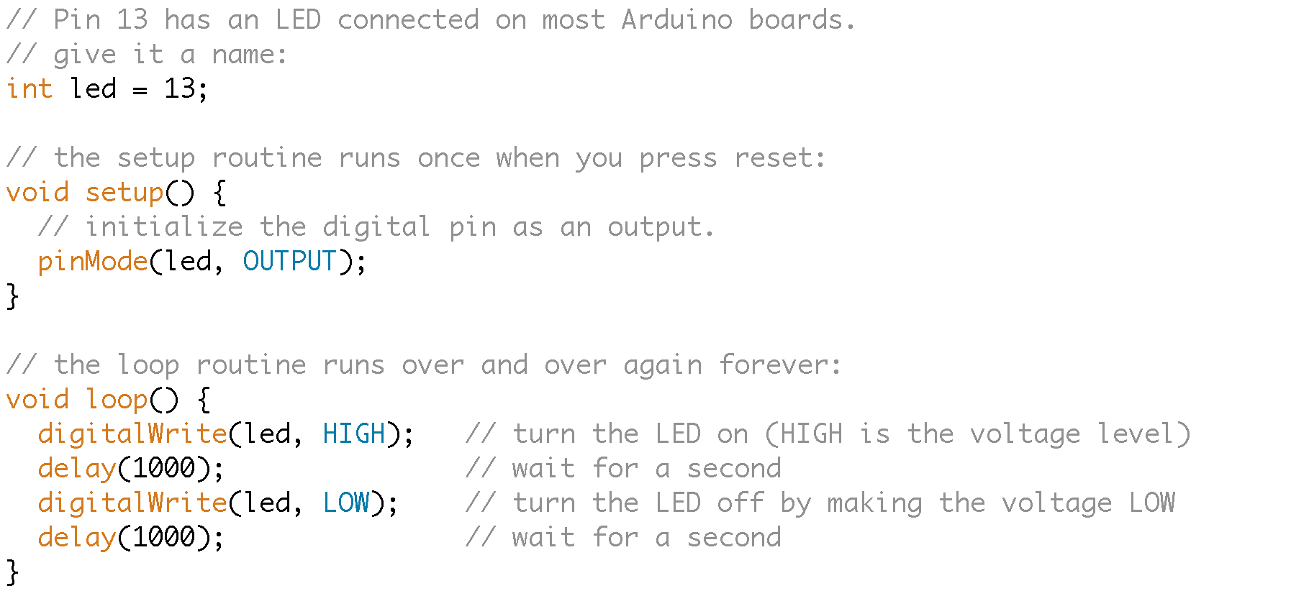
File > Examples > Basics > Blink sketch
Notes:
Find the “Blink” example.
Setup() and loop() are synonymous with Processing’s setup() and draw()
Remember how we said the digital pins can be inputs or outputs? pinMode() is how we tell them what to be. The first parameter is the pin number the second parameter is the mode: OUTPUT or INPUT (case sensitive). It is common practice to label all your pins up top. Get used to it.

Slide 32
File > Examples > Basics > Blink sketch
Notes:
Now that we have set our digital pins as OUTPUTS, we need to figure out how to turn them on and off.
Arduino understands write and read. Because we are OUTPUTTING information, we want to Write to the pin. So the digitalWrite() function will do this for us. the first parameter is which pin to turn on or off and the second parameter is what state to be in: HIGH or LOW. Once again, HIGH sets pin 13 to 5 volts while LOW sets it to 0 volts.
delay() is a function that just tells the arduino to wait for a certain number of milliseconds. BEWARE! The delay makes the entire arduino stop EVERYTHING for the duration of the delay. This means nothing else will run while it is on a delay(). Use it sparingly.
Try to change some code to make the LED blink with a different pattern.

Slide 33
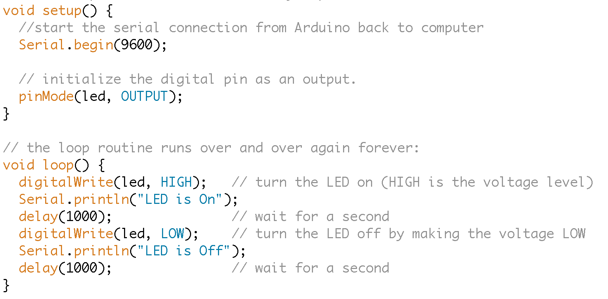
Add some “debugging” code
Notes:
Add some lines so we can see how the arduino sends messages to the serial monitor once it’s running.
Serial.begin(9600) opens up the Serial connection on the arduino and sets the speed that both sides will be talking 9600 is the “baud rate”
Serial.println(“text”) prints a line of text to the serial monitor. Note the println will print the line and end it with a carriage return (i.e. a new line). the Serial.print() command will not insert a new line after the text.
Now lets try to connect an external LED and get to know the breadboard

Slide 34
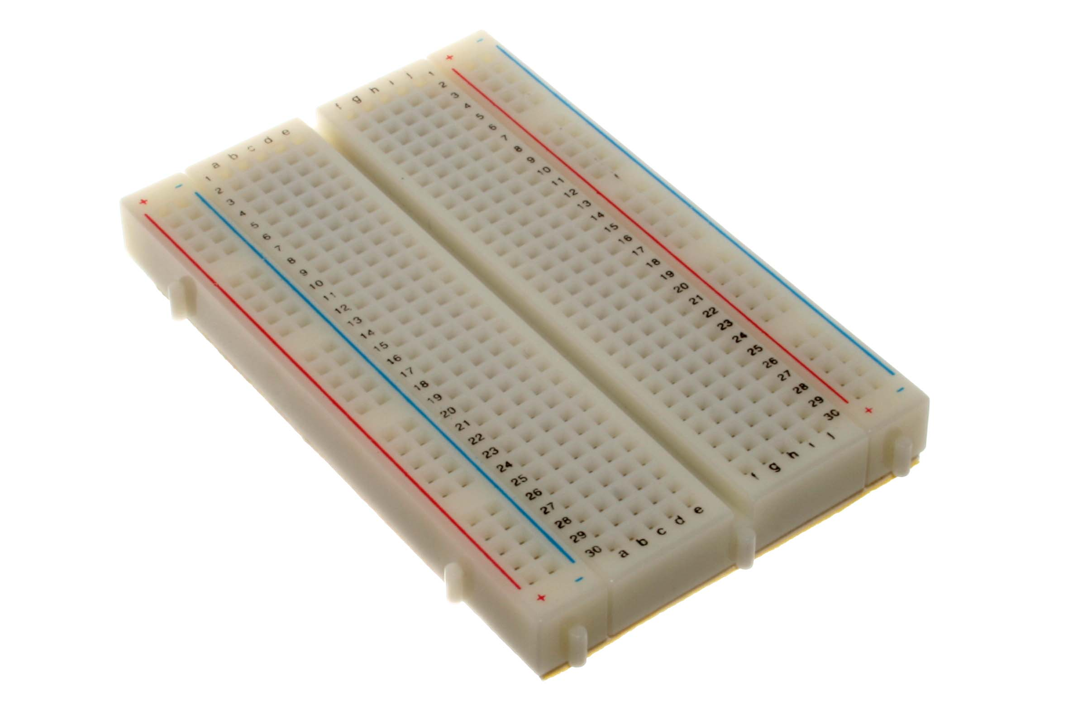
Breadboarding
Notes:
A breadboard (no idea why they call it that) is a great tool for prototyping because of how fast you can make reliable electrical connections.
The breadboard is just a bunch of metal pieces inside a box with a bunch of holes in it.

Slide 35
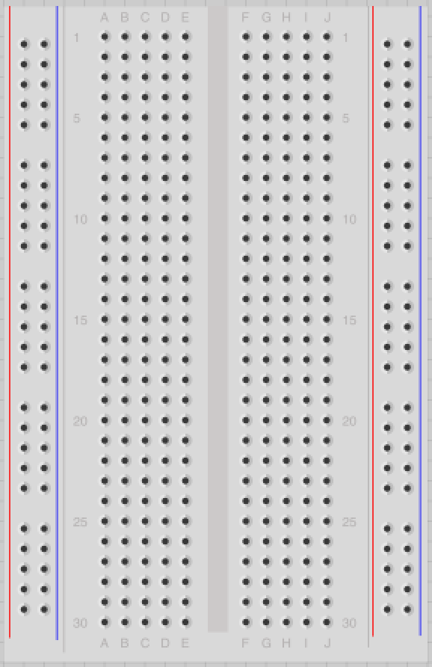
Breadboard Connections
Notes:
The horizontal rows of the breadboard are all connected underneath. This means that ANY two wires connected ANYWHERE on that row will now be electrically connected.

Slide 36
Breadboard Rows
Notes:
Note: the gap down the center of the breadboard is a real gap, rows are NOT connected to the ones next to them.

Slide 37
Breadboard Power/Ground “Rails”
Notes:
Along the edges of the breadboard you’ll find the Power and ground “rails”. Unlike the rows, these are all connected vertically. See how the red and blue stripes are unbroken? That shows you the connection goes all the way down.
Almost every electrical component you will use will require their own connection to power (i.e. 5 votls) or ground. By connecting the 5V or GND on the arduino ANYWHERE on the rails we can have a bunch of different places to connect other components to power and ground.
Note: the color of wires or the breadboard rails dont matter, they’re just pieces of metal. However, your life will be way easier if you color code (or try to whenever you can). So just do it.

Slide 38
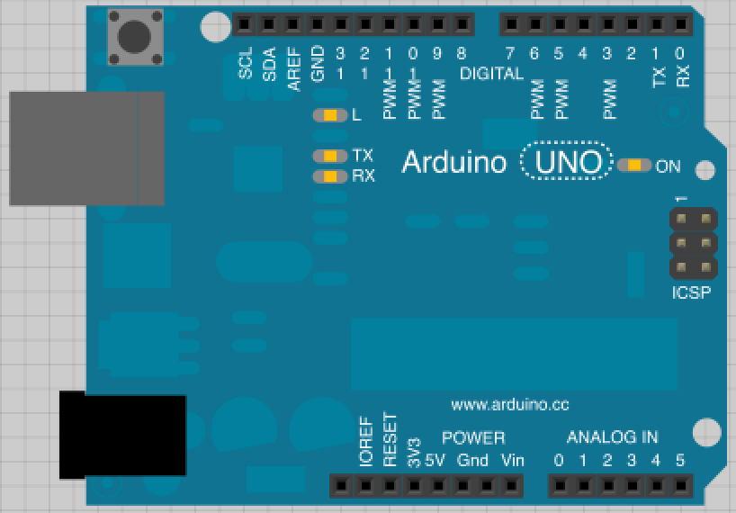
Connecting an LED
Notes:
UNPLUG YOUR ARDUINO FROM YOUR COMPUTER NOW
Until you are comfortable saying you an expert at physical computing, make sure you unplug your arduino when you make/change connections on the breadboard. One unfortunate short and you could fry your arduino or even worse, your USB port/laptop. For real.

Slide 39
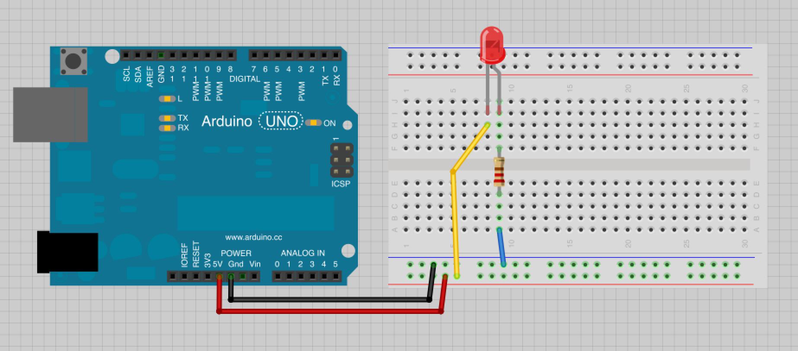
Connecting an LED
Notes:
Follow this wiring diagram. Make sure the resistor you use is the smaller resistor (200-600 ohms), not the 10 Kilo-ohm. Once you are sure it is connected correctly, plug in your arduino.
What do you think it will do? (answer below)
NOTE: The LED in the photo above is backwards. The short leg should be connected towards ground.
This led will be on 100% of the time because we are “hard-wiring” it directly to power. This isn’t what we want, we want the arduino to be able to control the state of the LED based on how it’s programmed.

Slide 40
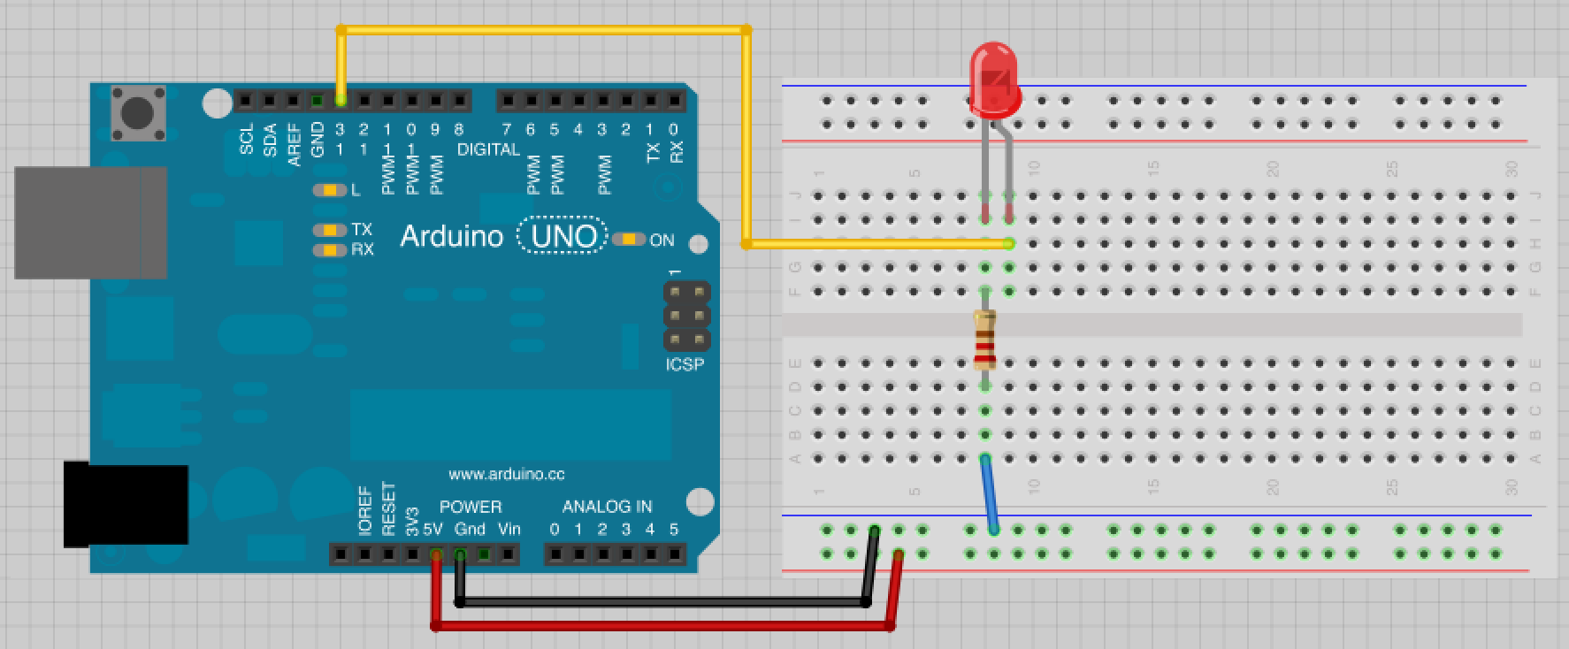
Control blink via Pin 13
Notes:
Now change the wire from the 5 volt rail to pin 13. Plug in your arduino (where your blink sketch should still be uploaded).
You will notice that the arduino is now causing the LED to blink on and off. Play around with the code and try to get the LED to blink in different patterns.
Why is it wired this way?
Always ask yourself: “which way is the electricity flowing?”
When pin 13 is set to LOW, both sides of the LED are 0 volts so no current is flowing and the led is off. When pin 13 is set to HIGH or 5V, current flows from the pin, through the LED, then the resistor into ground (current always goes from + to ground).

Slide 41
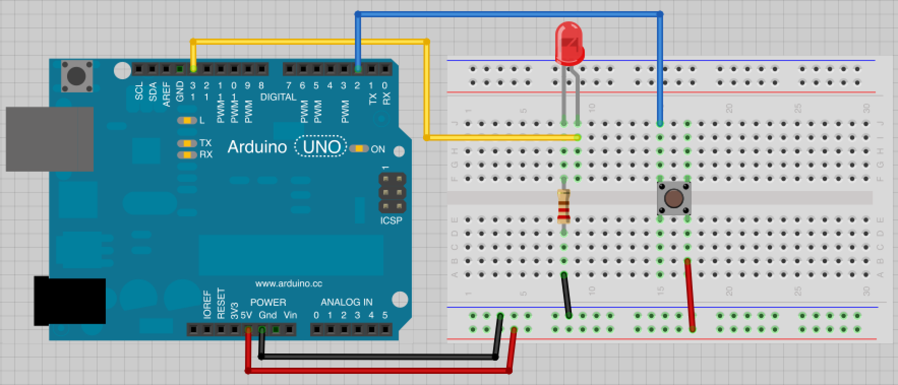
Manually blink using push button.
Notes:
We have an output that we can control (the LED), now lets add an input so that we can physically do things to influence the state of the output
DISCONNECT THE ARDUINO FIRST
Then hook up the button as shown. .
About the button: these simple (and cheap-o) buttons all have 4 legs. If it does not sit nicely in the breadboard (spanning the gap down the middle) then rotate it 90 degrees. It should pop in since the legs are a little curved. These buttons are basically two pieces of metal that are connected when you press the top. If viewed as in the diagram, the top left and bottom left legs are actually one piece of metal and the top right and bottom right are one as well (i.e. the blue wire and resistor are actually connected to the same thing, we just wired it this way specifically so everything looks neat on the breadboard).
Why do we wire it this way (and why do we need the resistor)?
Lets think again: “Which way is the electricity flowing?”
When the button isn’t pressed, the 5V side of the button is isolated from the Pin 2/resistor side of the button. This means that when we try to read Pin 2 we will only see that it is connected to ground.

Slide 42
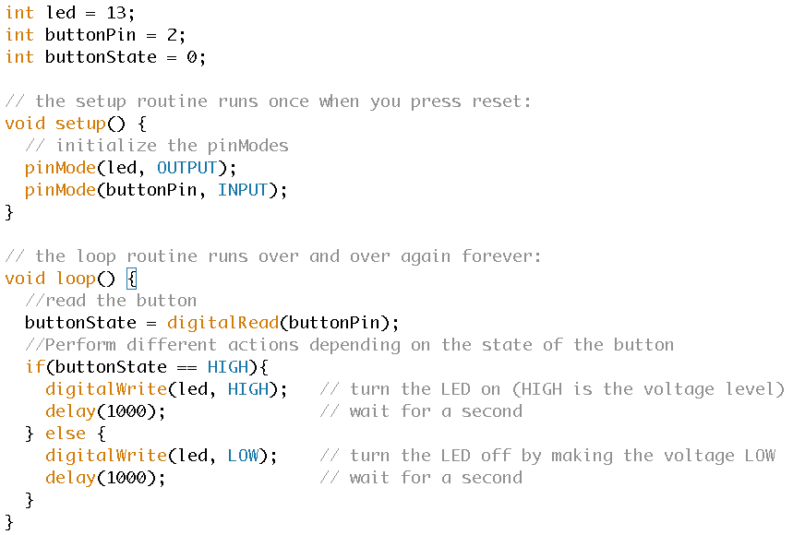
Read the button with code
Notes:
The serial.print commands have been removed to save space but can be left in if desired.
Code to add:
Declare global variables for buttonPin and buttonState
Set pinMode() of button to INPUT
Read the buttonPin with a digitalRead() command
Perform different actions depending on the state of the button with an if-else statement
Connect your arduino and upload the code

Slide 43
Connecting a Button
Notes:
What happens?
The button should turn on the led but it probably does so somewhat erratically. This was done for a reason.
When the button is pressed, the 5V side of the button connects to the Digital Pin 2 side. We then digitalRead() a HIGH signal and this causes the LED to be on. However, when the button is not pressed, the wire connected to DP2 is what we call a “floating pin”. This means it is not deliberately connected to anything like GND or 5V, its just connected to a random piece of metal on the breadboard.
Breadboards are notorious for being having “noisy” electrical signals and are subject to all sorts of static. This random electrical noise causes the floating pin (and hence the the result of the digitalRead() command) to bounce HIGH and LOW making it difficult for the arduino to tell when the button is actually not being pressed.
This button set up will work sometimes not others. Here’s how you fix it...

Slide 44

Add a “pull-down” resistor
Notes:
This resistor is there to “pull” one side of the button “down” to GND. Hence the name “pull-down resistor”.
Let’s take a look again at what is happening when we press the button:
When the button is pressed, the electricity will flow from the 5V side of the button to the other side. However it now has two places it can go: the way of the resistor into ground or into the digital pin. Because we used a large 10K resistor to ground the current will go the path of least resistance and flow into the digital pin. However, when the button is not pressed, the digital pin is now solely connected to the resistor to ground which very efficiently “grounds” the pin.
The overall effect is that the arduino can now reliably digitalRead() a LOW or 0 volts on pin 2 when the button is not pressed.

Slide 45
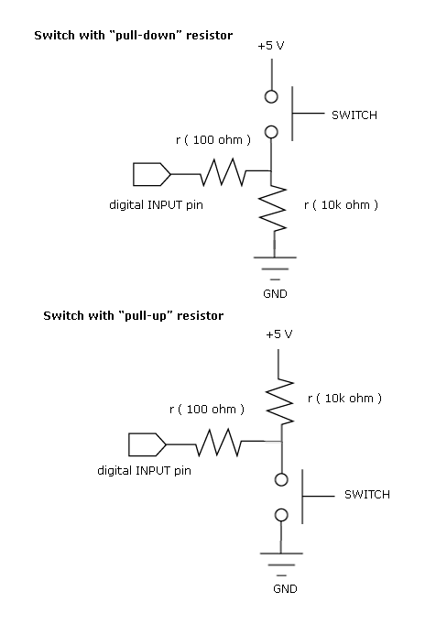
Pull-Up / Pull-Down Resistors
ensure that the signal will be a valid logic level if external devices are disconnected
Notes:
This resistor is there to “pull” one side of the button “down” to GND. Hence the name “pull-down resistor”.
Let’s take a look again at what is happening when we press the button:
When the button is pressed, the electricity will flow from the 5V side of the button to the other side. However it now has two places it can go: the way of the resistor into ground or into the digital pin. Because we used a large 10K resistor to ground the current will go the path of least resistance and flow into the digital pin. However, when the button is not pressed, the digital pin is now solely connected to the resistor to ground which very efficiently “grounds” the pin.
The overall effect is that the arduino can now reliably digitalRead() a LOW or 0 volts on pin 2 when the button is not pressed.

Slide 46
HOMEWORK
Update your code so the button triggers a state change
For example: the LED stays on when you push it and turns off when the button is pressed again
Try out different blink patterns
Documentation:
Upload your code to github with a link to the online video
Notes:
So far we are setting the LED to be on if the button is pressed. What if we wanted to make the LED stay on if the button is pressed once then turn off if the button is pressed again? In other words, cause the button to trigger a state change.
Your homework is to make this happen. However, it is not as straightforward as you might expect. You will have to research a concept known as “debouncing”. Learn what debouncing is then work around it. Be prepared to explain how your debounce code works (for all you copy-paste ninjas)!

